Slide 1


Student Score
Prediction Model
Assignment
DATA SERIES 12.0
AI Machine Learning
Muhamad Abdul Qodir Dani

Slide 2

Table of contents
01
02
03
Data Understanding
Load Data
Exploratory Data Analysis
& Feature Enginering
04
05
06
Data Splitting
Modelling Machine Learning
Model Evaluation
Dataset: https://drive.google.com/file/d/1tAww2rf2QEHKmq6bLNQA5TKWYnfOqC9x/view?usp=sharing

Slide 3


Data Understanding
This studen score data contains information about the total study time (in hours) and exam scores achieved by students. Each row represents one student, with two main columns, 'Hours' which shows the total hours studied, and 'Scores' which shows the exam scores achieved. Through this data, we can perform simple analysis and predictions to gain insights”

Slide 4
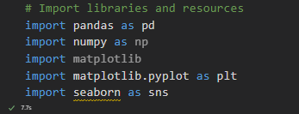
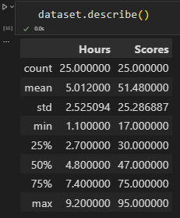
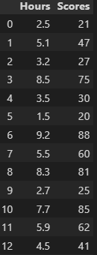
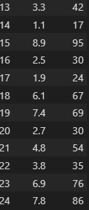
Load Data
1. import libraries and Dataset
2. Describe the Data
Import 5 libraries & Dataset from student_scores CSV with Pandas libraries as Dataframe
From the dataset there are 24 rows and 2 columns.

Slide 5
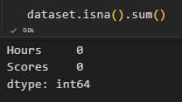

Explanatory Data Analysis & Feature Engineering
1. Check missing values and missing data all columns
from the data after we check it, it turns out that there are no missing values
2. Check Duplicate
from the data after we check it, it turns out that there is no duplicate data

Slide 6
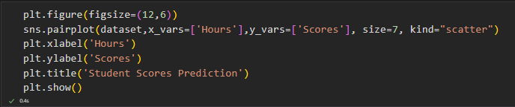
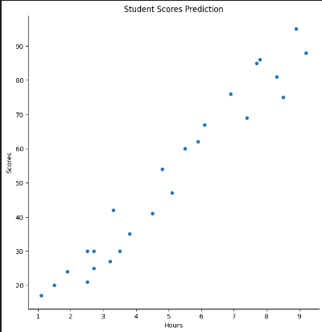
Explanatory Data Analysis & Feature Engineering
3. Student Scores Prediction
The graph shows the relationship between students' number of study hours (Hours) and their test scores (Scores). Based on the pattern of dots on the graph, there is a strong positive relationship between these two variables. This means that the more time students spend studying, the higher their test scores.

Slide 7
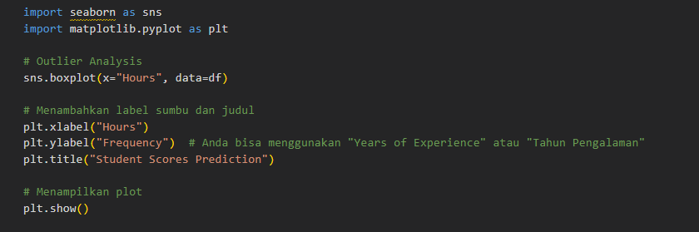
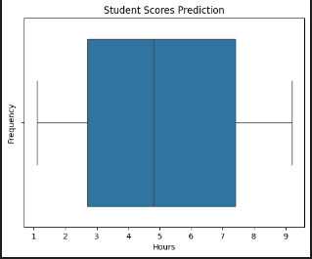
Explanatory Data Analysis & Feature Engineering
4. Outlier Analysis
In a boxplot, outliers are usually shown as points outside the whiskers. Since there are no points outside the whiskers on this graph, it can be concluded that there are no significant outliers in the distribution of the hours of study data. That is, all study hour values are within a reasonable range and there are no extreme or anomalous values.

Slide 8

Data Splitting
1. Import libraries for splitting data
2. Data Splitting
We split the dataset into two parts: one part for training the model (75%) and one part for testing the model's performance (25%).

Slide 9
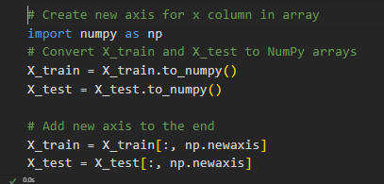
Modelling Machine Learning
Transformasi data
By adding a new dimension to the NumPy array, we can change the shape of the data to fit the requirements of machine learning models or other mathematical operations. This is a common data preparation step before training a model.

Slide 10


Modelling Machine Learning
1. Linear Regression model
Import libraries
Build model

Slide 11


Modelling Machine Learning
1. Linear Regression model
Predicting the scores for the Test values

Slide 12
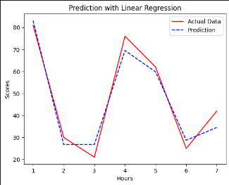
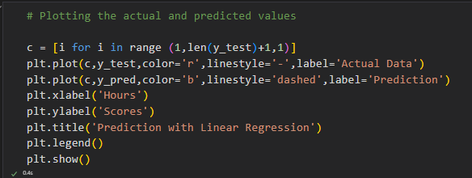
Modelling Machine Learning
1. Linear Regression model
Plotting the actual and predited values

Slide 13

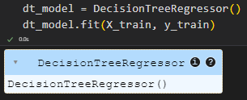
Modelling Machine Learning
2. Decision Tree Regressor
Import libraries
Build model

Slide 14
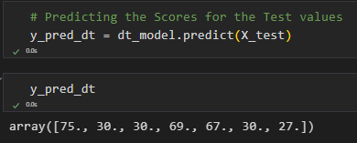
Modelling Machine Learning
2. Decision Tree Regressor
Predicting the scores for the Test values

Slide 15
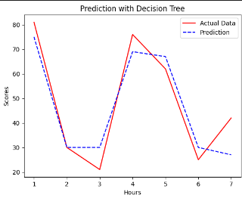
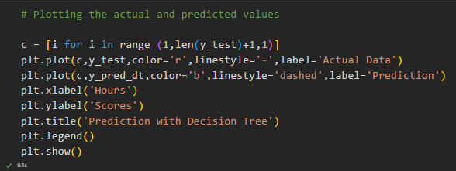
Modelling Machine Learning
2. Decision Tree Regressor
Plotting the actual and predited values

Slide 16

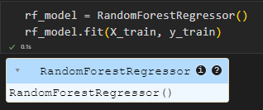
Modelling Machine Learning
3. Random Forest Regressor
Import libraries
Build model

Slide 17
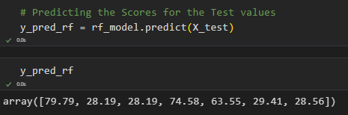
Modelling Machine Learning
3. Random Forest Regressor
Predicting the scores for the Test values

Slide 18
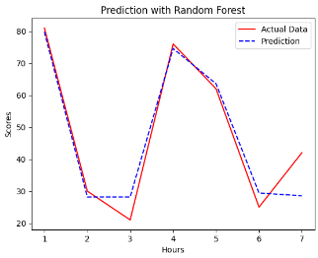
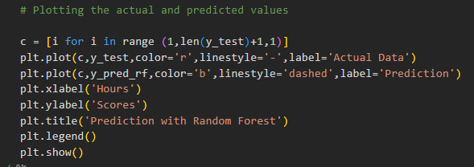
Modelling Machine Learning
2. Decision Tree Regressor
Plotting the actual and predited values

Slide 19
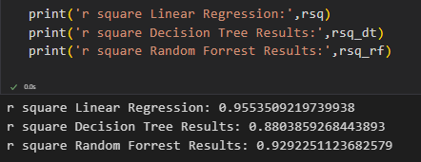

Model Evaluation
Coefficient of determination (R-squared) values of three different models
The Linear Regression model is the model that best explains the variability of the data in this case.
The Random Forest model also performed very well, and may be an alternative if there are other considerations such as model interpretation or handling non-linear data.
The Decision Tree model performed reasonably well, but not as well as the other two models.

Slide 20





Thank You
Muhamad Abdul Qodir Dani
mohamadkodir12@gmail.com
Muhamad Abdul Qodir Dani

